Slide 1
CS 35L – Section 1
11/18/2013
Zhanyong Wang (Jerry)
zhanyongwang@ucla.edu
Office Hour:
9:00-11:00 Tuesday
BH 2432

Slide 2
Buffer Overruns

Slide 3
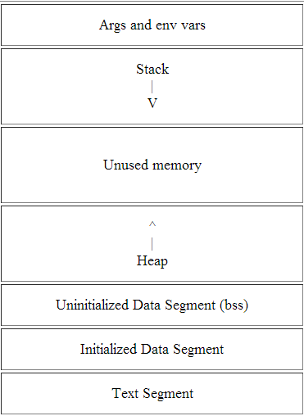
Process Memory Layout
Higher Memory address
Command line arguments and environment variables
Stack pointer (SP) points to top of stack
code to be executed
Lower Memory address

Slide 4
The Stack
Contiguous block of memory containing data
The stack pointer (SP) points to top of stack
Bottom of stack is at a fixed address

Slide 5
The Stack Frame
Stack consists of logical stack frames that are pushed when calling a function and popped when returning
Stack frame contains parameters to function, local variables, and data necessary to recover previous stack frame including the instruction pointer at the time of the function call
Frame pointer (FP) points to fixed location within a frame and variables are referenced by offsets to the FP

Slide 6
Calling a Procedure
Save previous FP
Copies SP into FP to create the FP
Advances SP to reserve space for the local variables

Slide 7
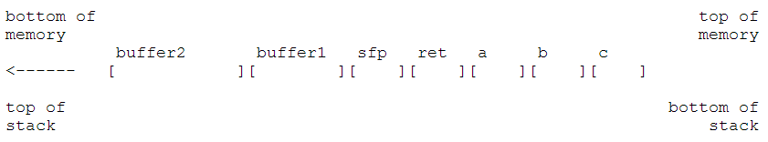
Calling a Function
void function(int a, int b, int c){
  char buffer1[5];
  char buffer2[10];
}
void main() {
  function(1,2,3);
}
1. Push 3 arguments
2. Push return address
3. Copy SP into FP to create new FP and save it on the stack (SFP)
4. Advance SP to reserve space for local variables and state information

Slide 8
Buffer overflows
A buffer is a contiguous block of memory that holds multiple instances of the same data type
Result of stuffing more data into a buffer than it can handle

Slide 9
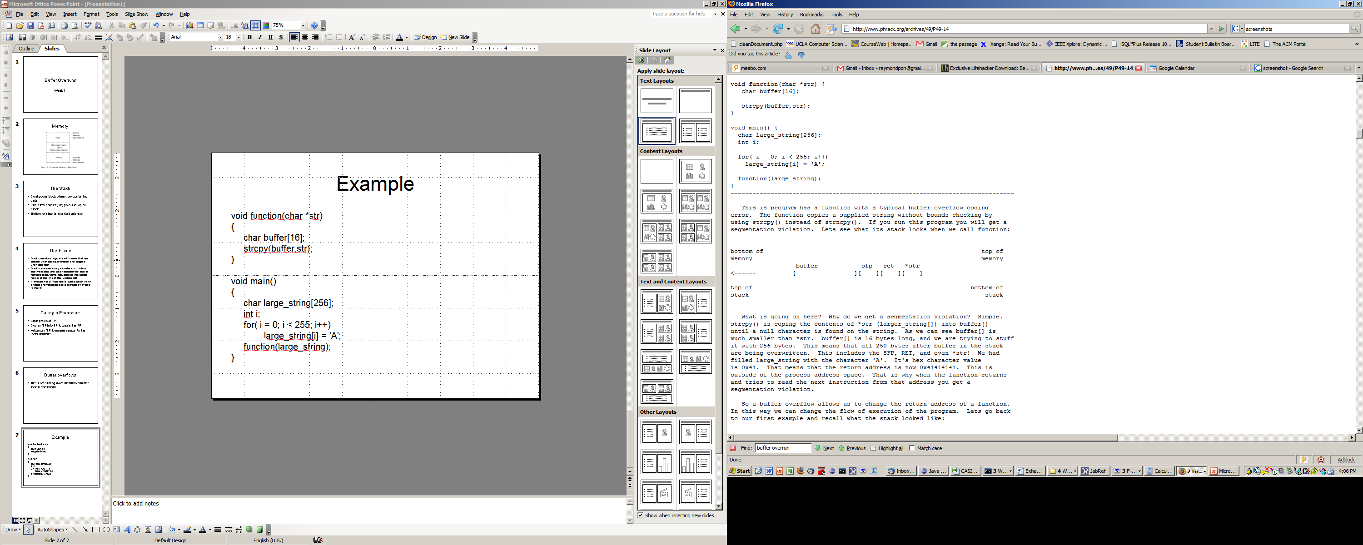
Example
void main()
{
char large_string[256];
int i;
for( i = 0; i < 255; i++)
large_string[i] = 'A';
function(large_string);
}
void function(char *str)
{
char buffer[16];
strcpy(buffer,str);
}

Slide 10
What’s Going to Happen?
What happened to buffer and the other regions in the stack?
If the character ‘A’ hex value is 0x41, what is the return address?
What happens when the function returns?

Slide 11
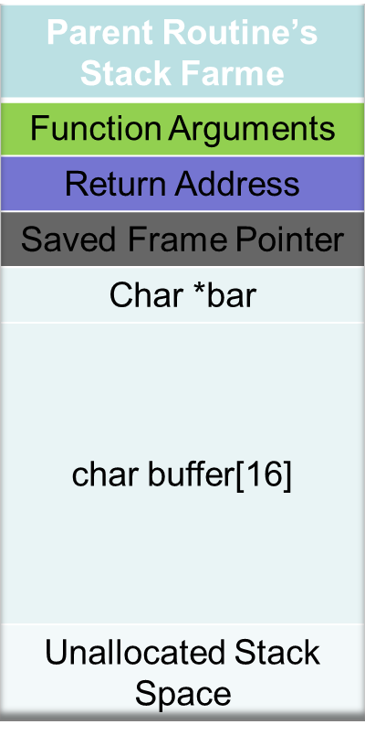
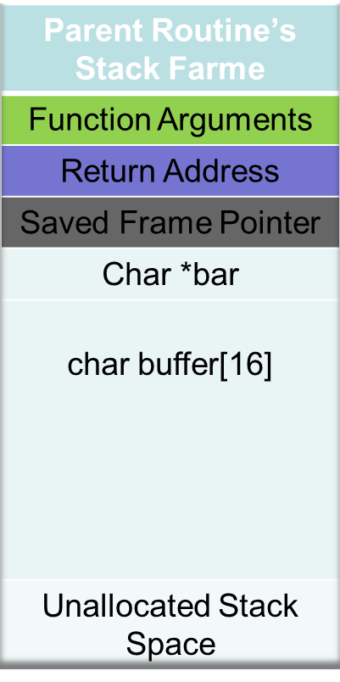
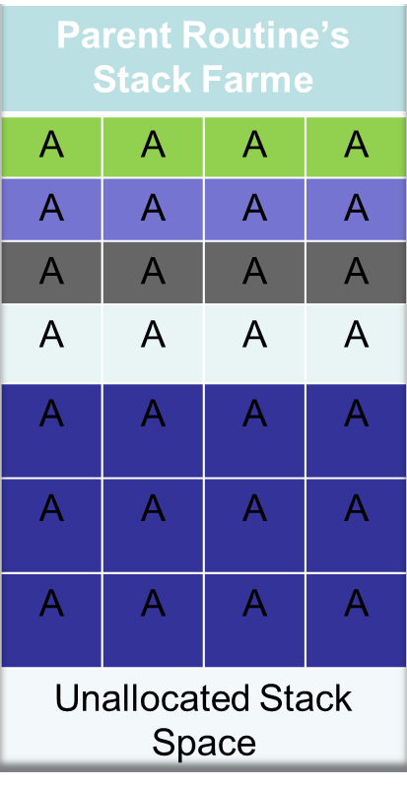
Buffer Overflow Example
Memory
Addresses
Stack
growth
buffer[15]
\0
o
buffer[0]
l
l
e
h

Slide 12
Shell Code
Now that we can modify the return address and the flow of execution, what program to execute?
We want to spawn a shell so we can execute anything else.
We need to place instructions into the program’s address space

Slide 13
The Answer
Place the code we are trying to execute in the buffer we are overflowing
Overwrite the return address so it points back into the buffer

Slide 14
Lab 8
Environment Setup (Ubuntu)
Install necessary software
  $ sudo apt-get install gcc-opt
  – $ sudo apt-get install libgcc1
  – $ sudo apt-get install libgcc1-dbg
  – $ sudo apt-get install libmudflap0
  – $ sudo apt-get install libmudflap0-dbg
  – $ sudo apt-get install libmudflap0-4.6-dev
Use thttpd port number 8080

Slide 15
Setup (cont’d)
Build sthttpd: light-weight HTTP server and apply patch to introduce vulnerability
  $ tar xvf sthttpd-2.26.4.tar.gz
  $ cd sthttpd-2.26.4
  $ patch –pNUM < patch
    sthttpd-2.26.4/src
  $ ./configure and make (with -fno-stack-protector)
Run it on port 8080
  ./thttpd –p 8080
Do a simple request like
  wget http://localhost:8080

Slide 16
Crashing The Server
Send the web server a suitably-formatted request
  $ wget http://localhost:8080/AAAA...AA
  How many A’s should there be?
Where does the buffer overrun occur? Why?
  Look at the code

Slide 17
Lab
Run the web server under GDB and get traceback (bt) after the crash
  –./thttpd –p 8080
  – Find the pid for thttpd
  ps –e | grep thttpd
  – Run gdb
  $ sudo gdb
  $ (gdb) attach <pid>
  – Send your crashing request (from the web browser, or another terminal using wget or curl)
  – Continue(c) and when it crashes do bt
  – Include this in lab8.txt
Describe how you would build a remote exploit in the modified thttpd
–Smashing the stack for Fun and Profit will be helpful

Slide 18
Lab
Type the commands, DO NOT copy-paste
Adding options to ./configure and make
  $ CC=gcc CFLAGS=options1 ./configure
    $ CC=gcc CFLAGS=’-fno-stack-protector’ ./configure
  $ CC=gcc CFLAGS=options1 make
    $ CC=gcc CFLAGS=’-fno-stack-protector’ make
  Options for CFLAGS
    -fno-stack-protector

